Slide 1
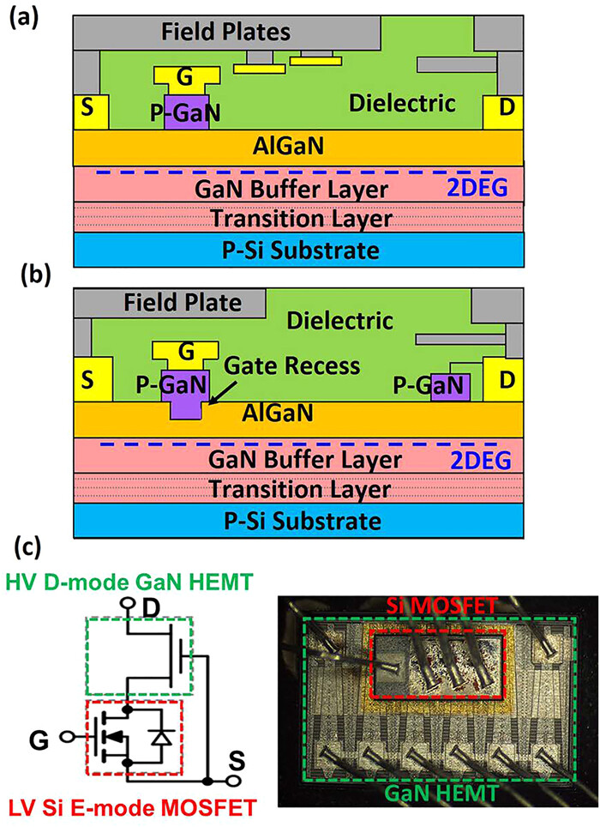
FIG. 2. Schematic or decapped photos of four mainstream commercial GaN HEMTs: (a) SP-HEMT, (b) GIT, and (c) cascode GaN HEMT.
Published in: Koon Hoo Teo; Yuhao Zhang; Nadim Chowdhury; Shaloo Rakheja; Rui Ma; Qingyun Xie; Eiji Yagyu; Koji Yamanaka; Kexin Li; Tomás Palacios; Journal of Applied Physics 130, 160902 (2021)
DOI: 10.1063/5.0061555
Copyright © 2021 Author(s)

